Slide 1

HR Data analysis dashboard
Hamza

Slide 2




Agenda
Problem introduction KPIs and lollipop chart pie chart frequency chart heat map bar chart donut chart summary live working video thank you

Slide 3
Problem
IN some company HR department wants dashboard
They have raw data they wont proper interactive representation of their database do understand and represent higher authority that how many employees are leaving their company from which field and department understanding their job satisfaction levels from which age band they are and their gender.

Slide 4



Introduction
The HR analytics dashboard is used in many companies it presents useful insights from data like employee count, attrition rate, shows department wise attrition, job satisfaction, loyalty, age bands of employees and I also created one interactive filter, action filter, So it provides total insight about HR department.

Slide 5
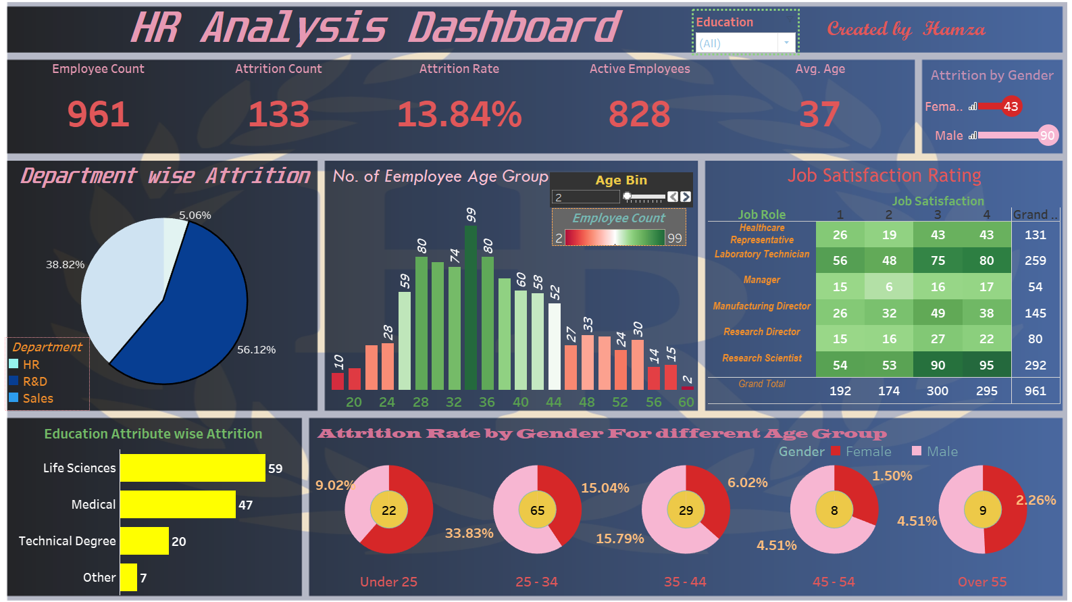
Subtle

Slide 6
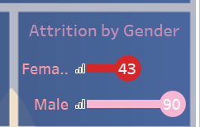
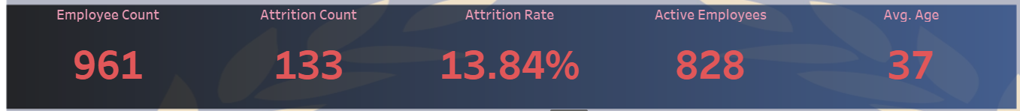
Custom chart or lollipop chat & KPI
It will give insight how many male and females are leaving company.
First KPI(key performance indicator) which gave insights on

Slide 7
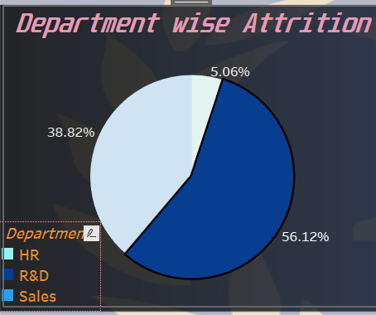
Pie chart
Shows department wise Attrition as we see 56% Attrition from sales department.

Slide 8
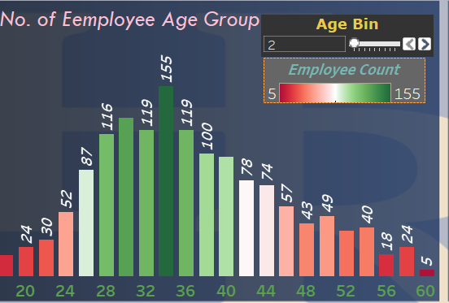
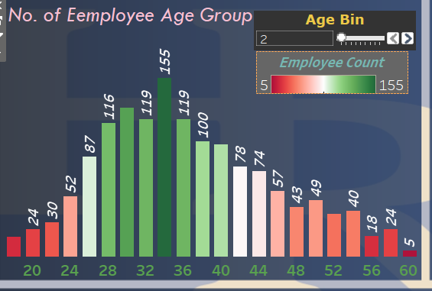
It is the frequency chart: It shows all our employees with particular age group.

Slide 9
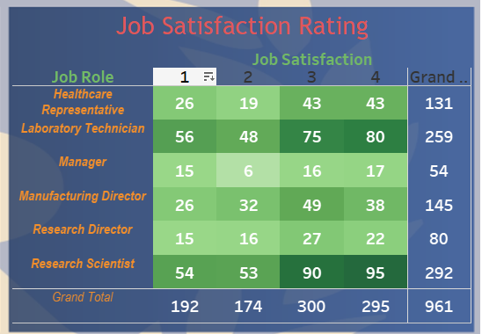
Matrix chart or heat map for
It shows different job roles with satisfaction example 95 employees are satisfied.

Slide 10
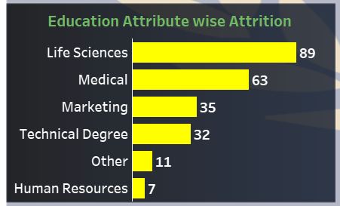
Bar chart
In education field wise Attrition >> Shows no. of employee left company from a particular education background .

Slide 11
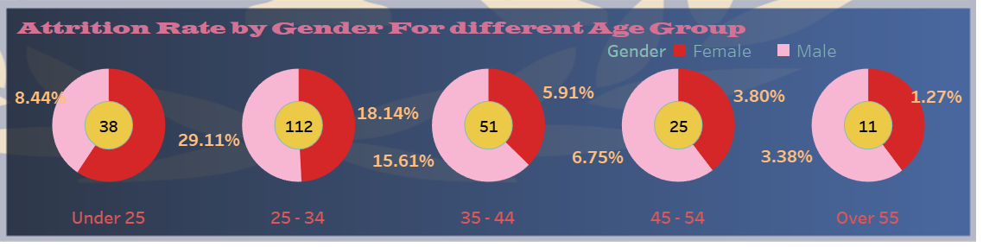
Donut chart’s
It gives insight how many no. of and percentage employee leaves the company from particular age.

Slide 12
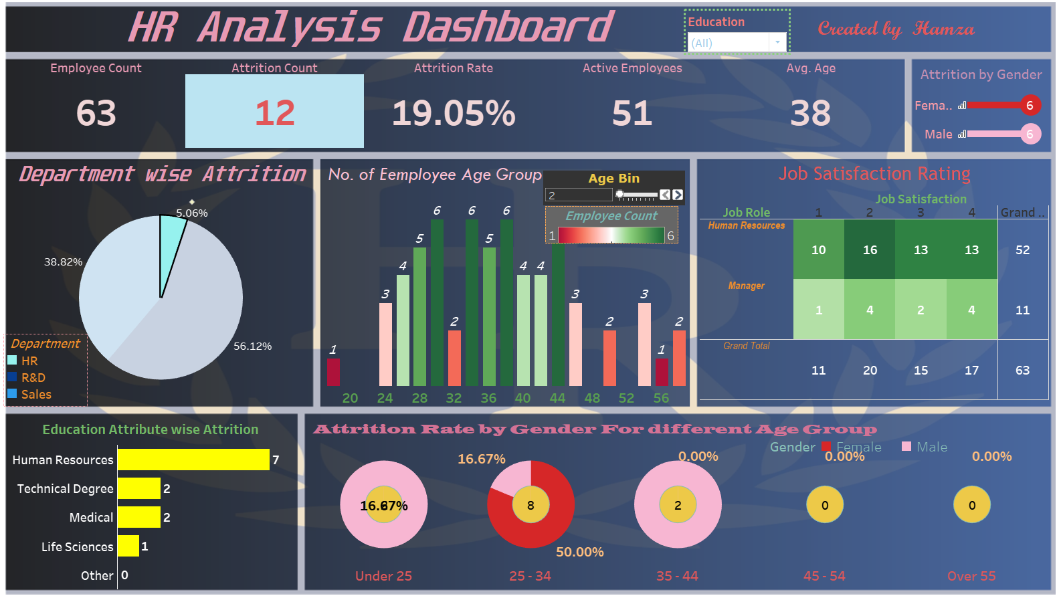

Summary
Hence this dashboard will provide useful info insights to reduce the attrition rate & tells areas on which company have to work on.
It makes Understand which age group and education background employee is leaving from which department.

Slide 13

Thank you
Presenter Name: Hamza
Email address: hamzashamim2001@gmail.com
7703993678

